Slide 1

Core-Course Project
Weather Watch
Harnessing Satellites for Real-Time Climate Insights
Mohamed Imran S (22EC073)
Mugundan G (22EC075)
Mentor
Mr.A.SENTHILKUMAR

Slide 2
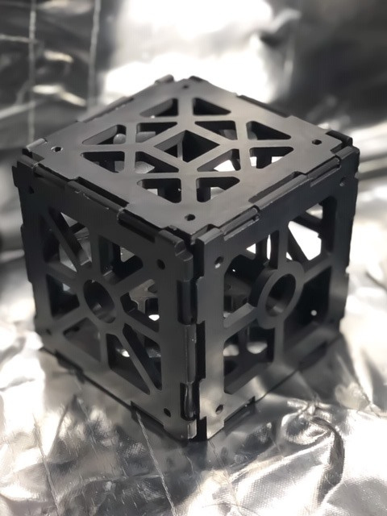

Overview
01
Abstract
02
Components Used
03
Circuit Diagram
04
Methodologies
05
Advantages
06
Complexities
07
Applications

Slide 3
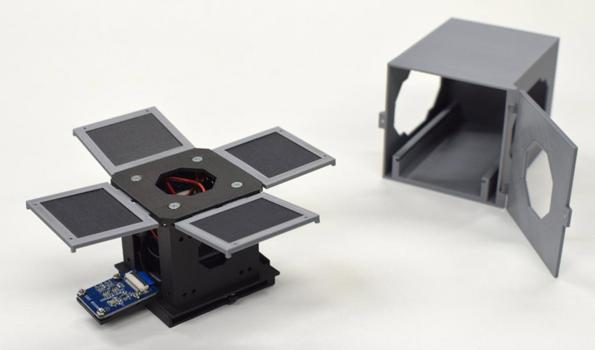

Abstract
Pi Weather is a groundbreaking project that leverages the Raspberry Pi Pico microcontroller and a suite of sensors to create a cost-effective and versatile weather monitoring satellite system.
traditional weather monitoring systems can be prohibitively expensive and inaccessible to many communities.
The Pi weather satellite is equipped with a Raspberry Pi Pico microcontroller, which serves as the central processing unit for collecting, analyzing, and transmitting weather data.
A range of sensors, including temperature, humidity, and pressure sensors, are integrated into the satellite to capture comprehensive environmental data.

Slide 4

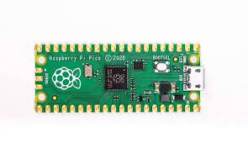
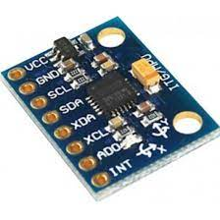
Components Used
Rpi pico Board
BMP Sensor
MQ2 sensor
MPU6050 sensor
SD Card Module
PCB Board
3d printed box
Software Used
Thonny- Micro Python

Slide 5
Methodologies
Hardware Selection and Integration:
Identify suitable hardware components, including the Raspberry Pi Pico microcontroller and compatible sensors (temperature, humidity, pressure, etc.).
Ensure compatibility and functionality of selected hardware components.
Data Acquisition and Processing:
Develop software to interface with the sensors and collect data from them.
Implement algorithms for processing raw sensor data to derive meaningful weather parameters (e.g., temperature, humidity, pressure).
Communication Protocols:
Establish communication protocols for transmitting weather data from the satellite to a ground station or other receiving devices.

Slide 6
Methodologies
Power Management:
Design power management systems to optimize energy usage and extend battery life.
Implement sleep modes and power-saving techniques to minimize power consumption during idle periods.
Ground Station Setup:
Set up a ground station to receive and process weather data transmitted by the satellite.
Testing and Validation:
Conduct comprehensive testing of the entire system, including hardware, software, and communication components.
Perform field tests under real-world conditions to validate system performance and reliability.

Slide 7
Advantages
Accessibility: PiWeather democratizes access to weather monitoring technology, empowering individuals and communities to monitor weather conditions with precision and reliability, even in remote or underserved areas.
Real-Time Data: PiWeather facilitates real-time data acquisition and transmission, providing users with up-to-date weather information for informed decision-making and timely response to weather events.
Versatility: The modular design of PiWeather allows for easy customization and expansion, enabling users to tailor the system to their specific needs and requirements.

Slide 8
Applications
Personal Weather Stations: Individuals can use PiWeather to set up personal weather stations at home or in their communities, allowing them to monitor local weather conditions.
Agriculture: PiWeather can be deployed in agricultural settings to monitor environmental conditions such as temperature, humidity, and rainfall, helping farmers optimize irrigation schedules, manage crop health, and mitigate the impacts of extreme weather events.
Education and Research: PiWeather provides a hands-on learning experience for students and researchers interested in meteorology, environmental science, and STEM fields. It can be used in educational settings to teach concepts related to weather monitoring, data analysis, and sensor technology.

Slide 9
Complexities

